Slide 1

Unit IV Memory Management, File Management & I/O Management
DEPARTMENT OF COMPUTER SCIENCE AND ENGINEERING

Slide 2
Syllabus Unit IV
Memory Management: Memory Management Requirements, Memory Partitioning: Fixed Partitioning, Dynamic Partitioning; paging, segmentation, virtual memory.
File Management: Overview, File Organization and Access, File Directories, File Sharing, Record Blocking.
I/O Management: I/O Devices, Organization of the I/O Functions, I/O Buffering, Disk Scheduling.
*
OPERATING SYSTEMS
2

Slide 3

Memory Management
Subdividing memory to accommodate multiple processes
Done by Memory Management module of OS
Memory needs to be allocated to ensure a reasonable supply of ready processes to consume available processor time
*
OPERATING SYSTEMS
3
Notes:
MIT-WPU
3

Slide 4
Memory Management Requirements
Relocation
Protection
Sharing
Logical Organization
Physical Organization
*
OPERATING SYSTEMS
4

Slide 5
Memory Management Requirements
Relocation
Programmer does not know where the program will be placed in memory when it is executed
While the program is executing, it may be swapped to disk and returned to main memory at a different location (relocated)
Memory references must be translated in the code to actual physical memory address
*
OPERATING SYSTEMS
5

Slide 6
Memory Management Requirements
Protection
Processes should not be able to reference memory locations in another process without permission
Impossible to check absolute addresses at compile time
Must be checked at run time
*
OPERATING SYSTEMS
6

Slide 7
Memory Management Requirements
Sharing
Allow several processes to access the same portion of memory
Better to allow each process access to the same copy of the program rather than have their own separate copy
*
OPERATING SYSTEMS
7

Slide 8
Memory Management Requirements
Logical Organization
Programs are written in modules
Modules can be written and compiled independently
Different degrees of protection given to modules (read-only, execute-only)
Share modules among processes
*
OPERATING SYSTEMS
8

Slide 9
Memory Management Requirements
Physical Organization
Memory available for a program plus its data may be insufficient
Overlaying allows various modules to be assigned the same region of memory
Programmer does not know how much space will be available
*
OPERATING SYSTEMS
9

Slide 10
Memory Partitioning
OS occupies some fixed portion of main memory and that the rest of main memory is available for use by multiple processes.
The simplest scheme for managing this available memory is to partition it into regions.
Types-
Fixed Partitioning
Dynamic Partitioning
*
OPERATING SYSTEMS
10

Slide 11
Fixed Partitioning
Partition regions with fixed boundaries.
Partition Sizes-
Two alternatives
Equal-size fixed partitions
Unequal-size fixed partitions
*
OPERATING SYSTEMS
11

Slide 12
Equal-size partitions
Any process whose size is less than or equal to the partition size can be loaded into an available partition
If all partitions are full, the operating system can swap a process out of a partition
A program may not fit in a partition. The programmer must design the program with overlays
Use of Main memory is inefficient in this case. Any program, no matter how small, occupies an entire partition. Here, there is wasted space internal to a partition. This is called internal fragmentation.
*
OPERATING SYSTEMS
12

Slide 13
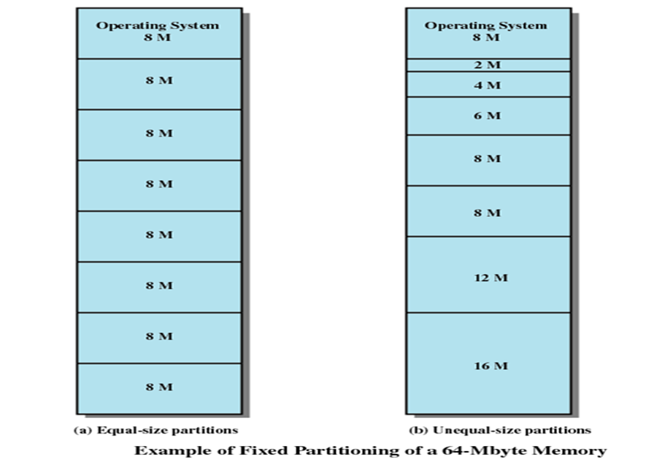
*
OPERATING SYSTEMS
13

Slide 14
Placement Algorithm with Partitions
Equal-size partitions
Because all partitions are of equal size, it does not matter which partition is used
Unequal-size partitions
Can assign each process to the smallest partition within which it will fit
Queue for each partition
Processes are assigned in such a way as to minimize wasted memory within a partition
*
OPERATING SYSTEMS
14

Slide 15
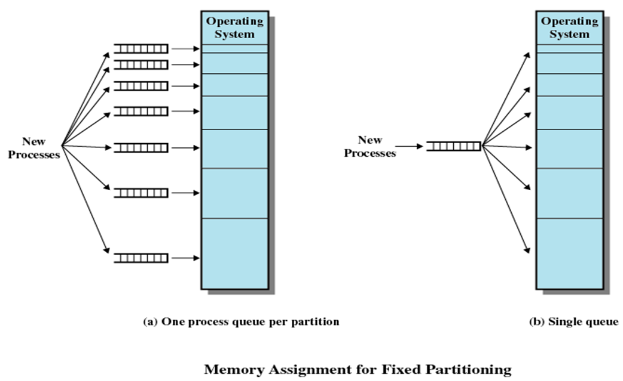
*
OPERATING SYSTEMS
15

Slide 16
Disadvantages
The number of partitions specified at system generation time limits the number of active processes in the system.
Small processes will not utilize space efficiently.
As well as, it is not reasonable to know the requirement of the process beforehand.
*
OPERATING SYSTEMS
16

Slide 17
Dynamic Partitioning
Partitions are of variable length and number
Process is allocated exactly as much memory as required
Eventually it leads to a situation in which there are a lot of small holes in the memory. This is called external fragmentation.
Overcome :
Must use compaction to shift processes so they are contiguous and all free memory is in one block.
*
OPERATING SYSTEMS
17

Slide 18
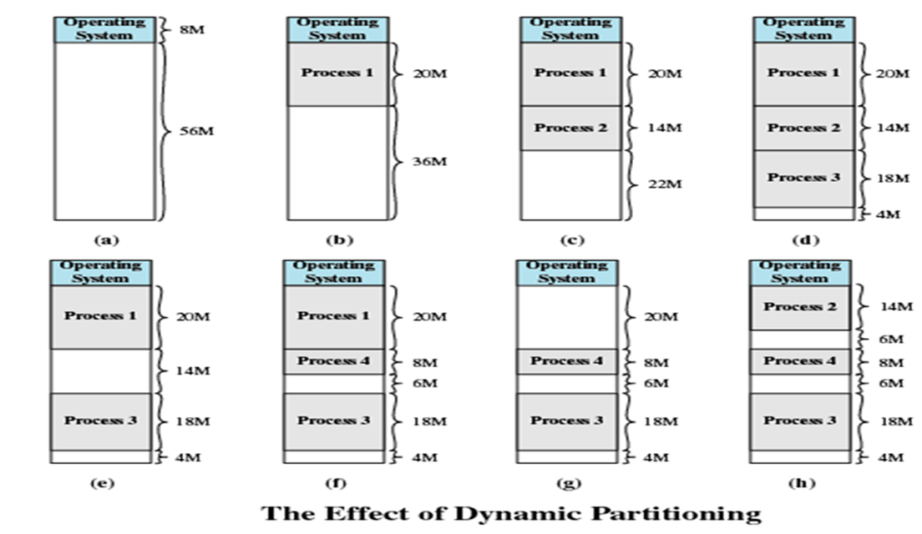
*
18
OPERATING SYSTEMS

Slide 19
What is compaction ?
Compaction is a technique in which the free space is collected in a large memory chunk to make some space available for processes. - In memory management, swapping creates multiple fragments in the memory because of the processes moving in and out. - Compaction refers to combining all the empty spaces together - Compaction helps to solve the problem of fragmentation, but it requires too much of CPU time. - It moves all the processes to one end and leaves one large free space for incoming jobs, instead of numerous small ones. - In compaction, the system also maintains relocation information and it must be performed on each new allocation of process to the memory
SCHOOL OF COMPUTER ENGINEERING AND TECHNOLOGY

Slide 20
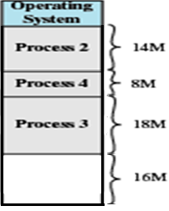
Compaction Problems
It wastes the processor time in shifting processes.
Compaction needs the dynamic relocation capability.
After Compaction
*
OPERATING SYSTEMS
20

Slide 21
Dynamic Partitioning Placement Algorithm
Operating system must decide which free block to allocate to a process.
Types:
Best-fit algorithm
First-fit algorithm
Worst-fit algorithm
*
OPERATING SYSTEMS
21

Slide 22
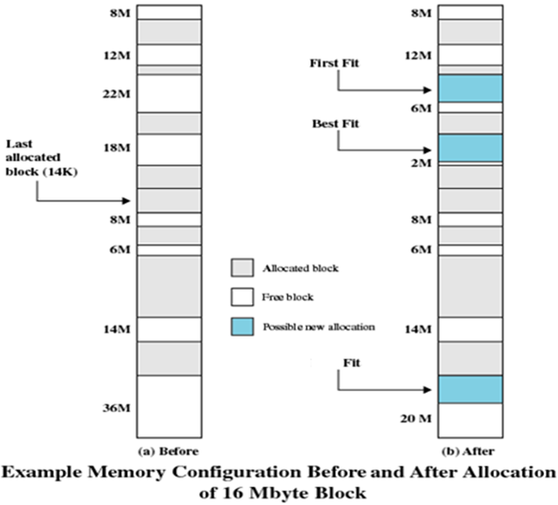
Dynamic Partitioning Placement Algorithm
Best-fit algorithm
Chooses the block that is closest in size to the request
Worst performer overall
Since smallest block is found for process, the smallest amount of fragmentation is left
Memory compaction must be done more often
*
OPERATING SYSTEMS
22

Slide 23
Dynamic Partitioning Placement Algorithm
First-fit algorithm
Scans memory from the beginning and chooses the first available block that is large enough
Fastest
May have many process loaded in the front end of memory that must be searched over when trying to find a free block
*
OPERATING SYSTEMS
23

Slide 24
Dynamic Partitioning Placement Algorithm
Worst Fit
Allocates a process to the partition which is largest sufficient among the freely available partitions available in the main memory.
If a large process comes at a later stage, then memory will not have space to accommodate it.
SCHOOL OF COMPUTER ENGINEERING AND TECHNOLOGY

Slide 25
Example 1
Free memory holes of sizes 15K, 10K, 5K, 25K, 30K, 40K are available. The processes of size 12K, 2K, 25K, 20K are to be allocated. How processes are placed in first fit, best fit, worst fit?
*
OPERATING SYSTEMS
25

Slide 26
Free memory holes of sizes 15K, 10K, 5K, 25K, 30K, 40K are available. The processes of size 12K, 2K, 25K, 20K are to be allocated. How processes are placed in first fit
First Fit: Search from beginning
Search ends when you find the
Hole havnig size >= size of process
Holes
15
10
5
25
30
40
Processes
15-12=3
12
Modified list of holes - After assigning 15K hole to 12K process
03
10
5
25
30
40
3-2=1
Modified list of holes - After assigning 3K hole to 2K process
2
01
10
5
25
30
40
*
OPERATING SYSTEMS
26

Slide 27
Continued ….
01
10
5
25
30
40
First Fit: Search from beginning
Search ends when you find the
Hole havnig size >= size of process
Holes
Processes
25-25=0
Modified list of holes - After assigning 25K hole to 25K process
25
01
10
5
30
40
30-20=10
20
Modified list of holes - After assigning 30K hole to 20K process
01
10
5
10
40
*
OPERATING SYSTEMS
27

Slide 28
Free memory holes of sizes 15K, 10K, 5K, 25K, 30K, 40K are available. The processes of size 12K, 2K, 25K, 20K are to be allocated. How processes are placed in Best fit
Best Fit: Search entire list
Find the holes whose size >= size of process. From these holes select the hole of smallest size
Holes
15
10
5
25
30
40
Processes
15-12=3
12
Modified list of holes - After assigning 15K hole to 12K process
03
10
5
25
30
40
3-2=1
2
Modified list of holes - After assigning 3K hole to 2K process
01
10
5
25
30
40
*
OPERATING SYSTEMS
28

Slide 29
Continued ….
Best Fit: Search entire list
Find the holes whose size >= size of process. From these holes select the hole of smallest size
Holes
01
10
5
25
30
40
Processes
25-25=0
25
Modified list of holes - After assigning 25K hole to 25K process
01
10
5
30
40
30-20=10
20
Modified list of holes - After assigning 30K hole to 20K process
01
10
5
10
40
*
OPERATING SYSTEMS
29

Slide 30
Free memory holes of sizes 15K, 10K, 5K, 25K, 30K, 40K are available. The processes of size 12K, 2K, 25K, 20K are to be allocated. How processes are placed in Worst fit
Worst Fit: Search entire list
Find the holes whose size >= size of process. From these holes select the hole of largest size
Holes
15
10
5
25
30
40
Processes
40-12=28
12
Modified list of holes - After assigning 40K hole to 12K process
15
10
5
25
30
28
2
30-2=28
Modified list of holes - After assigning 30K hole to 2K process
15
10
5
25
28
28
*
OPERATING SYSTEMS
30

Slide 31
Continued ….
Worst Fit: Search entire list
Find the holes whose size >= size of process. From these holes select the hole of largest size
Holes
15
10
5
25
28
28
Processes
28-25=3
25
Modified list of holes - After assigning 28K hole to 25K process
15
10
5
25
03
28
28-20=8
20
Modified list of holes - After assigning 28K hole to 20K process
15
10
5
25
03
08
*
OPERATING SYSTEMS
31

Slide 32
Paging
Main memory is partitioned into equal fixed size chunks that are relatively small ---- called frames
Each process is divided into small fixed sized chunks of the same size ---- called pages
At a given point of time, some frames are in use & some are free
Suppose process A stored on disk, consists of four pages.
When process is to be loaded , OS finds four free frames & loads A’s pages
These frames need not be contiguous
OS maintains a page table for each process
Page table consists of frame location for each page of the process
*
OPERATING SYSTEMS
32

Slide 33
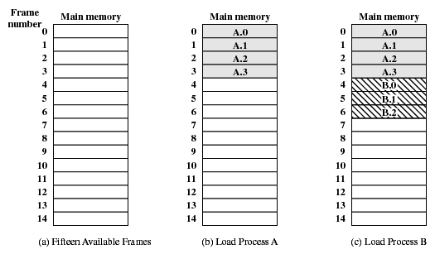
Assignment of Process Pages to Free Frames
*
OPERATING SYSTEMS
33

Slide 34
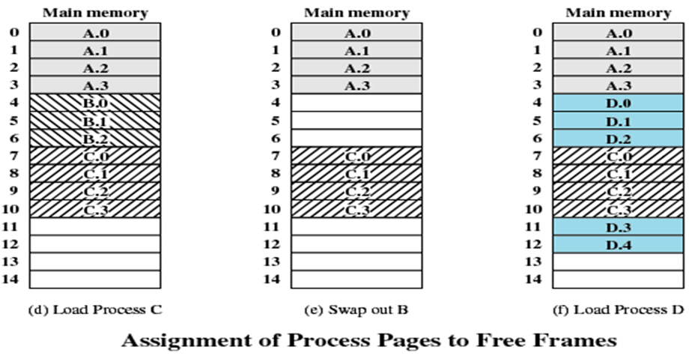
Assignment of Process Pages to Free Frames
*
OPERATING SYSTEMS
34

Slide 35
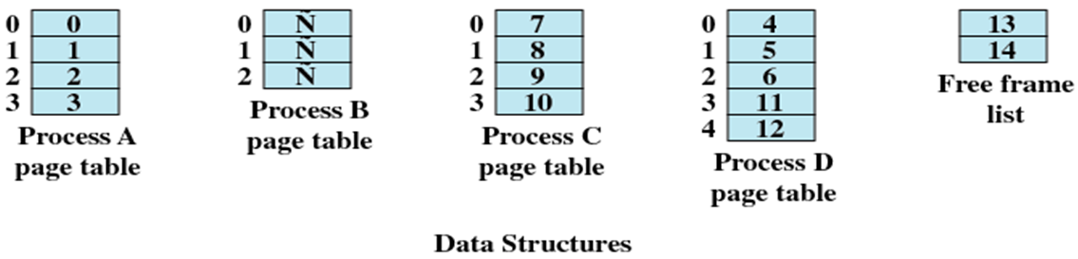
Page Tables for Example
*
OPERATING SYSTEMS
35

Slide 36
Segmentation
All segments of all programs do not have to be of the same length
Addressing consist of two parts - a segment number and an offset
Since segments are not equal, segmentation is similar to dynamic partitioning
*
OPERATING SYSTEMS
36

Slide 37
Logical View of Segmentation
1
1
4
2
3
4
2
3
user space
physical memory space
Operating System Concepts

Slide 38
Virtual Memory
*
OPERATING SYSTEMS
38

Slide 39
Virtual Memory
Memory references are dynamically translated into physical addresses at run time
A process may be swapped in and out of main memory such that it occupies different regions
A process may be broken up into pieces that do not need to located contiguously in main memory
All pieces of a process do not need to be loaded in main memory during execution
*
OPERATING SYSTEMS
39

Slide 40
Execution of a Program
Operating system brings into main memory a few pieces of the program
Resident set - portion of process that is in main memory
An interrupt is generated when an address is needed that is not in main memory
Operating system places the process in a blocking state
*
OPERATING SYSTEMS
40

Slide 41
Continued…
Piece of process that contains the logical address is brought into main memory
Operating system issues a disk I/O Read request
Another process is dispatched to run while the disk I/O takes place
An interrupt is issued when disk I/O complete which causes the operating system to place the affected process in the Ready state
*
OPERATING SYSTEMS
41

Slide 42
Advantages of Breaking up a Process
More processes may be maintained in main memory
Only load in some of the pieces of each process
With so many processes in main memory, it is very likely a process will be in the Ready state at any particular time
A process may be larger than all of main memory
*
OPERATING SYSTEMS
42

Slide 43
Types of Memory
Real memory
Main memory
Virtual memory
Memory on disk
Allows for effective multiprogramming and relieves the user of tight constraints of main memory
The two techniques used to implement the concept of Virtual Memory are Paging and Segmentation
*
OPERATING SYSTEMS
43

Slide 44
Thrashing
Swapping out a piece of a process just before that piece is needed
The processor spends most of its time swapping pieces rather than executing user instructions
*
OPERATING SYSTEMS
44

Slide 45
Paging Continued…
Each process has its own page table
Each page table entry contains the frame number of the corresponding page in main memory
A bit is needed to indicate whether the page is in main memory or not
*
OPERATING SYSTEMS
45

Slide 46
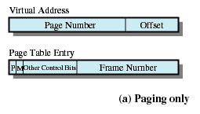
Paging Continued…
P /V:Present or Valid : Is the page in memory
M : Modify Bit
Other control bits : access control bits- read, write, exec
*
OPERATING SYSTEMS
46

Slide 47
Modify Bit in Page Table
Modify bit is needed to indicate if the page has been altered since it was last loaded into main memory
If no change has been made, the page does not have to be written to the disk when it needs to be swapped out
*
OPERATING SYSTEMS
47

Slide 48
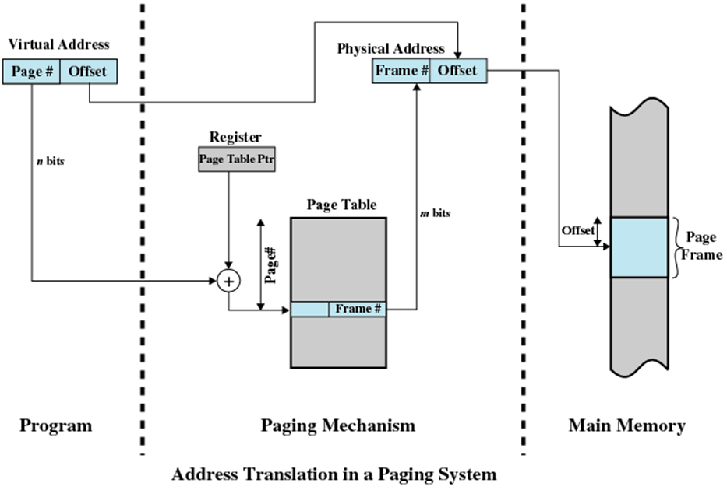
*
48

Slide 49
Page Tables
The entire page table may take up too much main memory
Page tables are also stored in virtual memory
When a process is running, part of its page table is in main memory
*
OPERATING SYSTEMS
49

Slide 50
Fetch Policy
Determines when a page should be brought into memory. Two alternatives:
1. Demand paging only brings pages into main memory when a reference is made to a location on the page
Many page faults when process first started
2. Prepaging brings in more pages than needed
More efficient to bring in number of contiguous pages at one time rather than bringing one at a time
Ineffective as most of the extra pages that are brought in are not referenced.
*
OPERATING SYSTEMS
50

Slide 51
Replacement Policy
A page fault occurs when a program attempts to access data or code that is in its address space, but is not available in the main memory
Frame Locking
Associate a lock bit with each frame
If frame is locked, it may not be replaced
Example:
Kernel of the operating system
Key Control structures
*
OPERATING SYSTEMS
51

Slide 52
Locality of Reference
Several studies suggest a strong tendency of programs to favor subsets of their address spaces during execution
This phenomenon is known as locality of reference & there are 2 types
Spatial locality: Is the tendency for a program to reference clustered locations in preference to randomly distributed locations e.g. sequential processing of arrays.
It suggests that once an item is referenced, there’s high probability that it or its neighboring items are going to be referenced in the near future
2. Temporal locality: Is the tendency for a program to reference the same location or a cluster several times during brief intervals of time e.g. loops
*
OPERATING SYSTEMS
52

Slide 53
Locality of Reference
Research suggests that executing program moves from one locality to another in the course of its execution
Locality of reference suggests that a significant portion of memory references of the executing program may be made to a subset of its pages
There’s increased probability that recently referenced pages, pages in the same locality are going to be referenced in the near future
These findings are utilized in implementing page replacement policies
*
OPERATING SYSTEMS
53

Slide 54
Basic Page Replacement Algorithms
Deals with selection of a page in main memory to be replaced when a new page must be brought in
First In First Out (FIFO)
Optimal Policy
Least Recently Used (LRU)
*
OPERATING SYSTEMS
54

Slide 55
First-in, first-out (FIFO)
Treats page frames allocated to a process as a circular buffer
Pages are removed in round-robin style
Simplest replacement policy to implement
Page that has been in memory the longest is replaced
These pages may be needed again very soon
*
OPERATING SYSTEMS
55

Slide 56
Example
We are considering following page reference string and three frames
*
OPERATING SYSTEMS
56

Slide 57
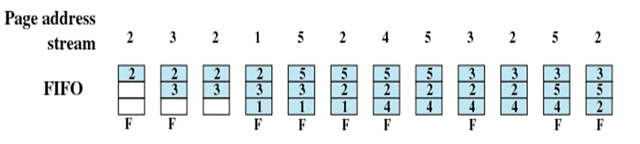
Example
*
OPERATING SYSTEMS
57

Slide 58
Belady’s Anomaly
The reference string is
1, 2, 3, 4, 1, 2, 5, 1, 2, 3, 4, 5.
Find the number of page faults for 3 frames & 4 frames
*
OPERATING SYSTEMS
58

Slide 59
Belady’s Anomaly
Reference string: 1, 2, 3, 4, 1, 2, 5, 1, 2, 3, 4, 5
3 frames
4 frames
FIFO Replacement – Belady’s Anomaly
more frames ⇒ less page faults
1
1
4
5
2
2
1
3
9 page faults
3
3
2
4
1
1
5
4
2
2
1
5
10 page faults
3
3
2
4
4
3
Operating System Concepts

Slide 60
Belady’s Anomaly
This most unexpected result is known as Belady’s Anomaly.
For FIFO page-replacement algorithm, the page-fault rate may increase as the number of allocated frames increases.
It is expected that giving more memory to a process would improve its performance.
In some early research, investigators noticed that this assumption was not always true.
Discovery of Belady’s Anomaly led to the discovery of Optimal Page Replacement algorithm which never suffers from Belady’s Anomaly
*
OPERATING SYSTEMS
60

Slide 61
Optimal policy
Selects for replacement that page for which the time to the next reference is the longest
Impossible to have perfect knowledge of future events
Page Address Stream: 2 3 2 1 5 2 4 5 3 2 5 2
*
OPERATING SYSTEMS
61

Slide 62
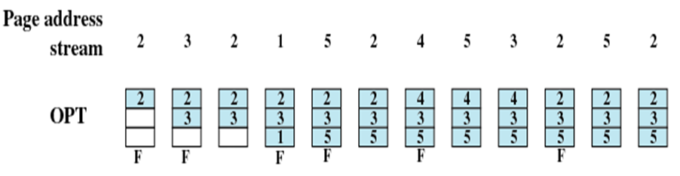
Example
*
OPERATING SYSTEMS
62

Slide 63
Least Recently Used (LRU)
Replaces the page that has not been referenced for the longest time
Each page could be tagged with the time of last reference. This would require a great deal of overhead
*
OPERATING SYSTEMS
63

Slide 64
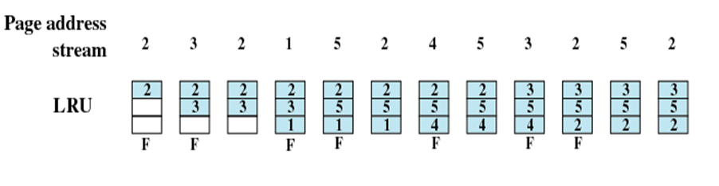
Example
*
OPERATING SYSTEMS
64

Slide 65
Example
Reference string: 1, 2, 3, 4, 1, 2, 5, 1, 2, 3, 4, 5
3 frames
4 frames
Operating System Concepts

Slide 66
References
1. William Stallings, Operating System: Internals and Design Principles, Prentice Hall, ISBN-10: 0-13-380591-3, ISBN-13: 978-0-13-380591-8, 8th Edition
21/02/19
Operating system
66
Notes:
66
MIT-WPU

